Slide 1

Inventory Management Program CST-117 Evan Wilson Instructor: Dr. Kris Jamsa 10 June 2018
Milestone 5

Slide 2
For the final milestone in this project, I had a few key focuses: -Improve visual UI/UX (UI/UX was largely ignored throughout the process while focusing on functionality. -Add two new functions: remember login option and save order file -More in depth debugging
Wilson’s Electronics

Slide 3
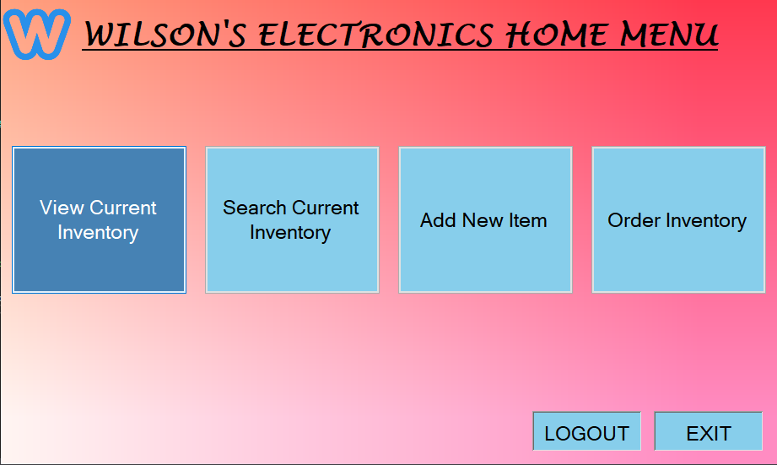
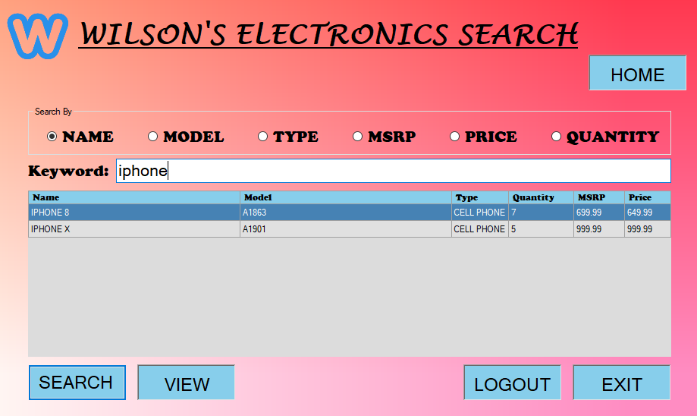
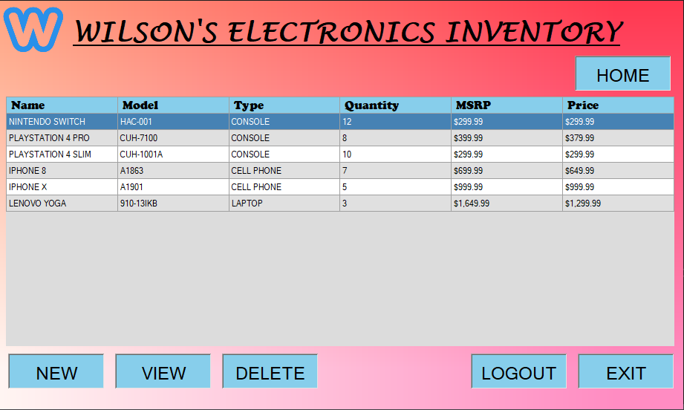
To improve the user interface and experience, I did the following: -All screens smaller and of equal size. -Changed the look of all buttons, making them uniform and adding mouse over effects. -Generic Wilson’s electronics logo put on each screen -Gradient panel background consistent across all forms -Changes to all data grids for a better visual look

Slide 4
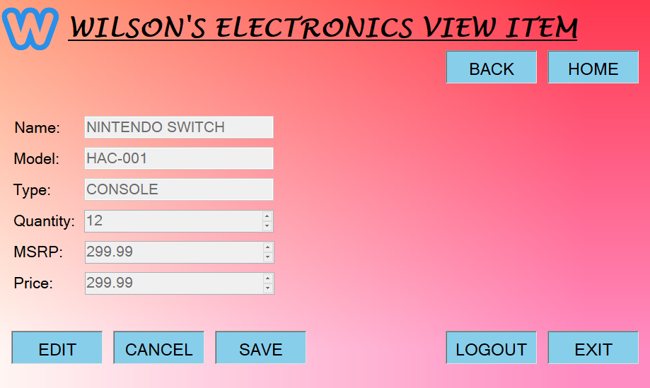

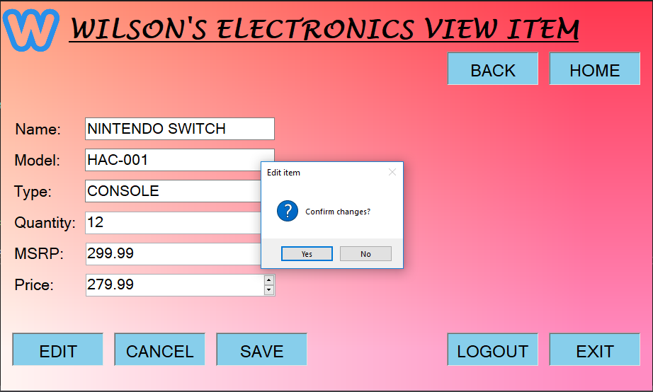
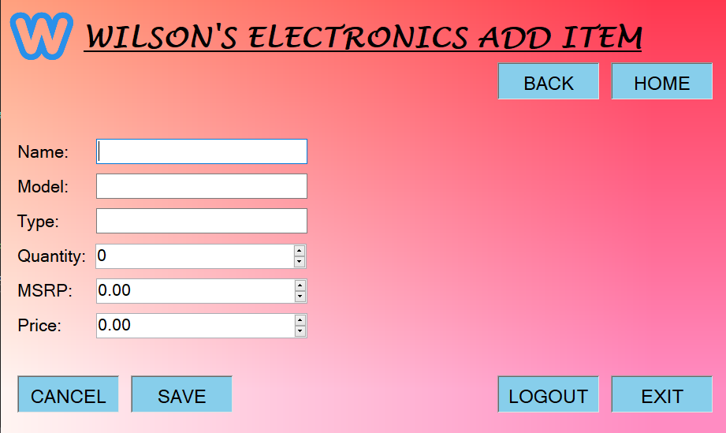
Continued screenshots of UI/UX improvements:

Slide 5
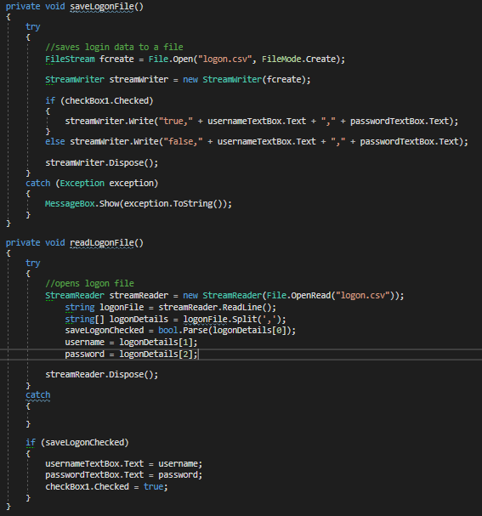
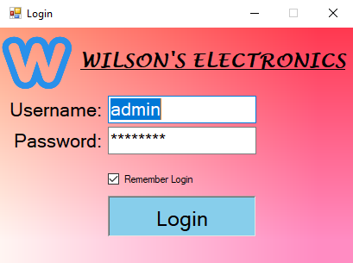
Here is an added feature separate from requirements, the ability to save and remember login information. Utilize a checkbox to “remember login” and save information to a separate CSV file. For actual release, would add ability to save authorized login information to a file and add functionality to add new users, change passwords etc.

Slide 6
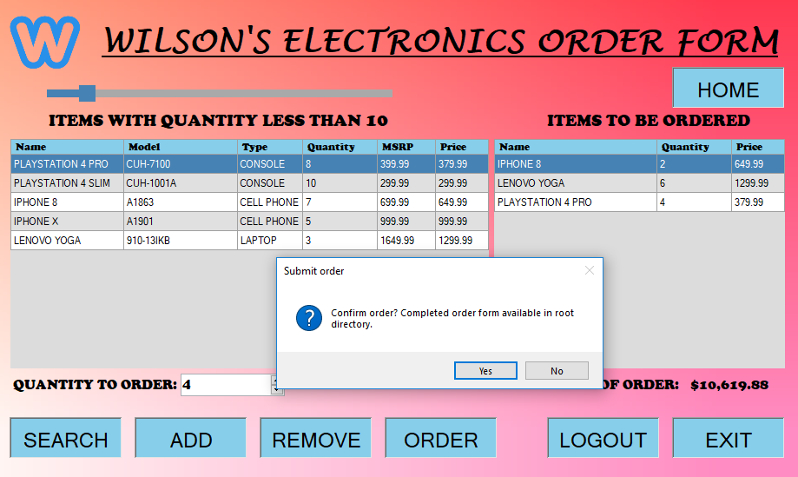
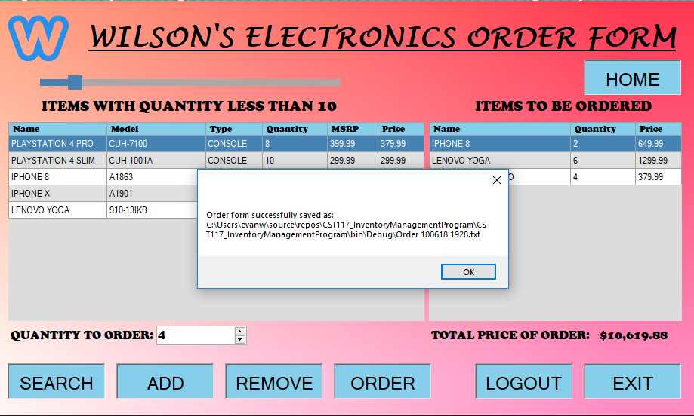
Significantly changed order form screen in the following ways: -Changed order data grid to only show necessary information for order form, including total of each item -Added feature to allow user to select how many of an item to order, and error handling to prevent values less than 1. -Order button now successfully saves an order form text file with current date and time

Slide 7
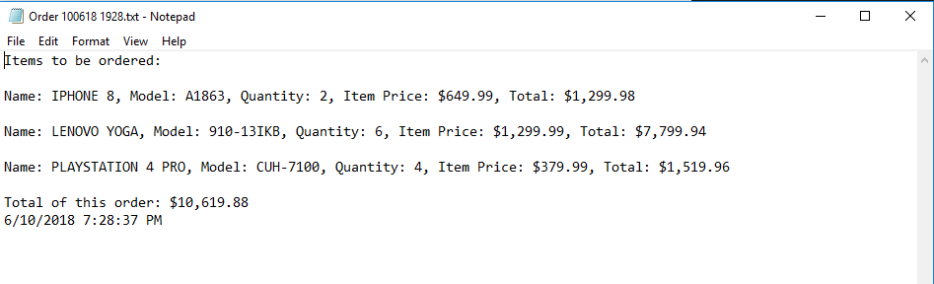
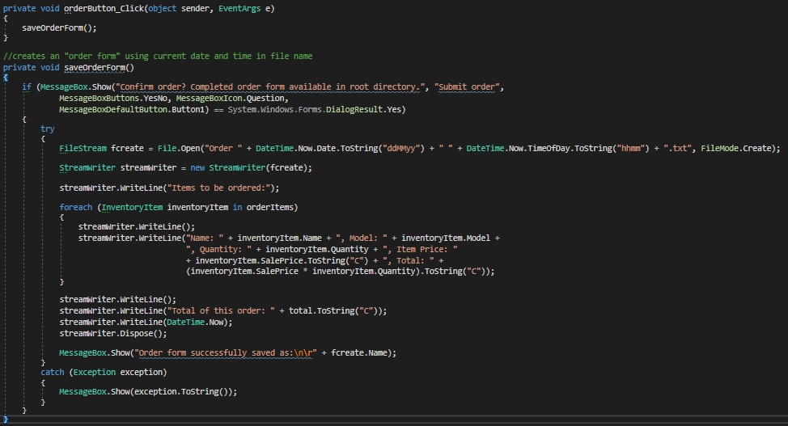
Additional screenshots of the order form that is saved, and the code that accomplishes it:

Slide 8
General debugging:
Fixed a logic error that would sometimes cause edits to be saved to the first inventory item in the Inventory List, replacing whatever was previously there.
Fixed a new bug caused by creating the ability to allow user to select quantity to order, the logic error would permanently alter the current quantity associated with that inventory item. This was caused because the new List<InventoryItem> still referenced the same inventoryItem in memory as the InventoryList<InventoryItem>
Fixed a logic error where the add new item screen and view item screens back button would always return to the home screen regardless of what screen was previously shown.
Wilson’s Electronics

